Slide 1
Doctoral Student
Networking Workshop:
Peer Networking Through
Writing Groups
Ace Beorchia, University of Tennessee
Terrance L. Boyd, Louisiana State University
Sara E. Davis, Mississippi State University
November 5, 2021
0

Slide 2
PhD Program

Slide 3
Academic Conferences

Slide 4
Academic Conferences

Slide 5
Doctoral Student Networks
Future employment
Professionalization
Insights into the
field’s demands
Other opportunities
(King, 2016)

Slide 7
Benefits
Types
Writing Group
Start-up
Panel

Slide 8
Common Graduate Student Writing Barriers
Isolation
Discipline
Motivation

Slide 9
Writing Group Benefits
Emotional support
Accountability to progress goals
Intellectual community
Detailed feedback on your work
Research collaboration
New resources, perspectives, and ideas
(Lee & Golde, Hume Writing Center; Stanford University)

Slide 10
Types of Writing Groups
Accountability Group
Review Group
Topical Group

Slide 11
Accountability Group
Purpose: To set small, incremental goals to accomplish during the writing session
Structure: Group meets to write together (virtual office)
Composition: Free for all! Anyone needing encouragement and accountability are ideal
Benefits: Increases motivation, short term writing productivity
Notes:
TL

Slide 12
Review Group
Purpose: To improve writing skills and receive feedback on early drafts.
Structure: A group member submits writing to a group who reviews the draft and sends back a friendly review. The group discusses the writing during the meeting.
Composition: Similar research interests/foundations; Similar program stage.
Benefits: Improve writing quality and quantity; Practice reviewing.
Notes:
ACE

Slide 13
Topical Group
Structure: To discuss the process of a shared topic (e.g., first year paper, dissertation)
Purpose: Group members share experiences and provide guidance on various aspects of the project
Composition: Working on a similar project. Best for everyone if at similar stages.
Benefits: Ability to share insight from various networks.

Slide 14
Writing Group Start-Up Process
Start with who you know
Make connections across institutions
Focus on connecting with a few people at each conference
Send an email explaining your idea and goals to potential members
Determine the type of writing group you are interested in creating
Introduce your basic ideas, but leave room for negotiation and co-construction
When someone joins, snowball sample to your desired group size

Slide 15
6 Things to Discuss When Starting
How often will the group meet, for how long, and where?
What format will you follow at each meeting?
What are the “formal” roles group members will play?
What will be shared, discussed, or reviewed?
When and how will members submit for feedback?
What kind of feedback is reasonable?
(Lee & Golde, Hume Writing Center; Stanford University)

Slide 16
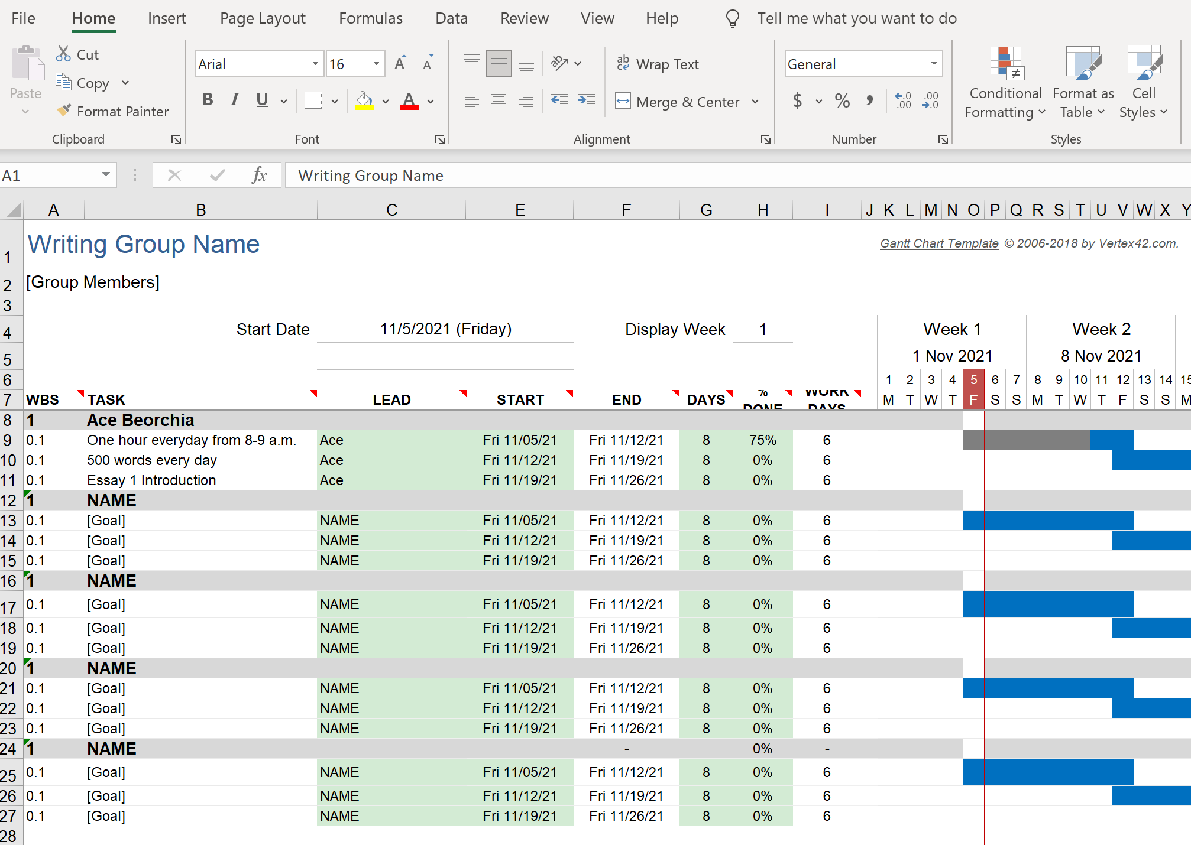

Slide 17
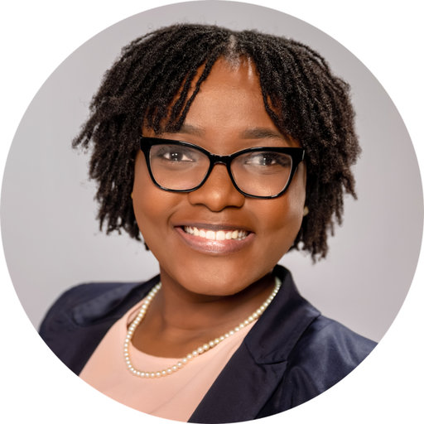
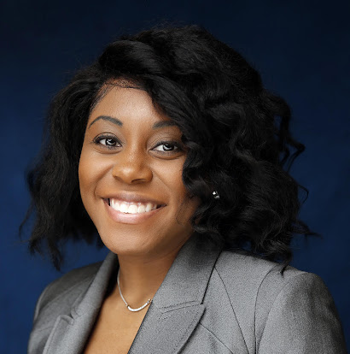
Writing Group Panel
Esther Jean, University of Texas at Arlington
MaQueba Massey, Jackson State University
Ashley Roccapriore, University of Tennessee
David Skandera, University of Central Florida
Marla L. White, University of Texas at Arlington

Slide 18
Writing Group Panel
What inspired you to join a writing group?

Slide 19
Writing Group Panel
If you had to give your main writing group an identity and personality, what would it be? Who would your group most likely attract and interact with?

Slide 20
Writing Group Panel
What practical advice would you give to other students wanting to form a writing group?

Slide 21
Writing Group Panel
What has been the most beneficial aspect of your writing group for you personally?

Slide 22
Writing Group Panel
What are some “no no’s” when it comes to writing groups? What automatically diminishes the success of a writing group?

Slide 23
Writing Group Panel
We can and should grow from our mistakes. What is a particular or significant mistake you have made along your journey? What have you learned from it?

Slide 24
Writing Group Panel

Slide 25
Collaborator Scavenger Hunt
Objective: initiate networking with other doc students who may be interested in writing groups
To access worksheet, scan this code →
Notes:
https://docs.google.com/spreadsheets/d/1pB78I_BPuJGfZVU6UsjiZkse97MNWSne_gFpFRk8OMQ/edit?usp=sharing

Slide 26
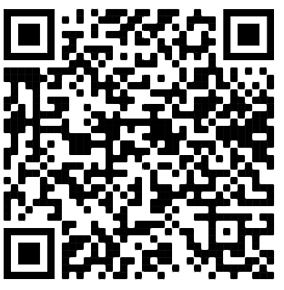
Peer Networking Through
Writing Groups
0
Stay Connected!
Google Contact Sheet
Notes:
https://docs.google.com/spreadsheets/d/1uGrXzN8bwBJ65s-FmHnNQR7vJcb8G7OiB41qxwn3xGg/edit?usp=sharing

